Slide 1

Python Project: Credit Card Churner Prediction

Slide 2

Project Description
Credit card company is losing money
Customers are churning their cards
How do we stop it from happening?

Slide 3
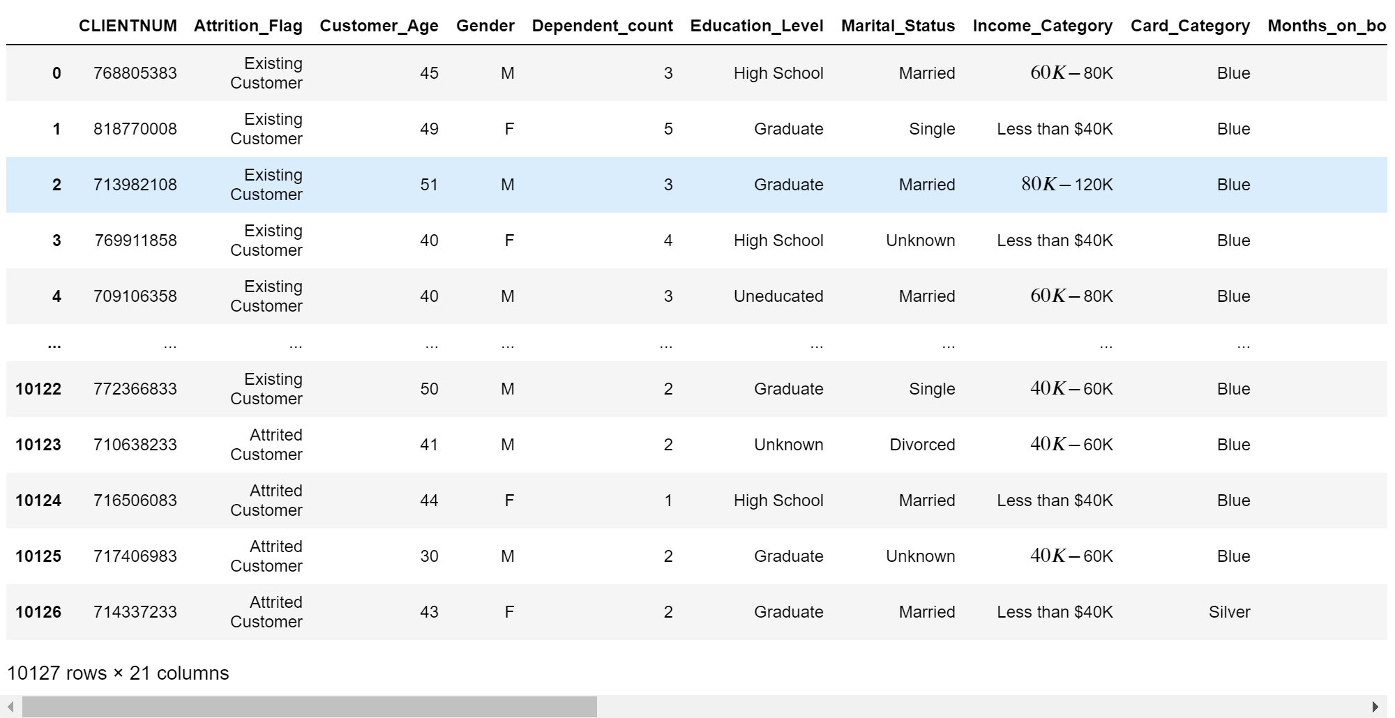
The Dataset
Data of 10,000+ customers
Contains 20 columns
Provides data on:
Person’s demographic
Credit card activity

Slide 4
Describe my planljdahfiauhffksjfhaiwf
Filter out the group that churned their cards
Find out how their data differs from what the current card holder data
Use those factors find people who might also cancel their cards

Slide 5
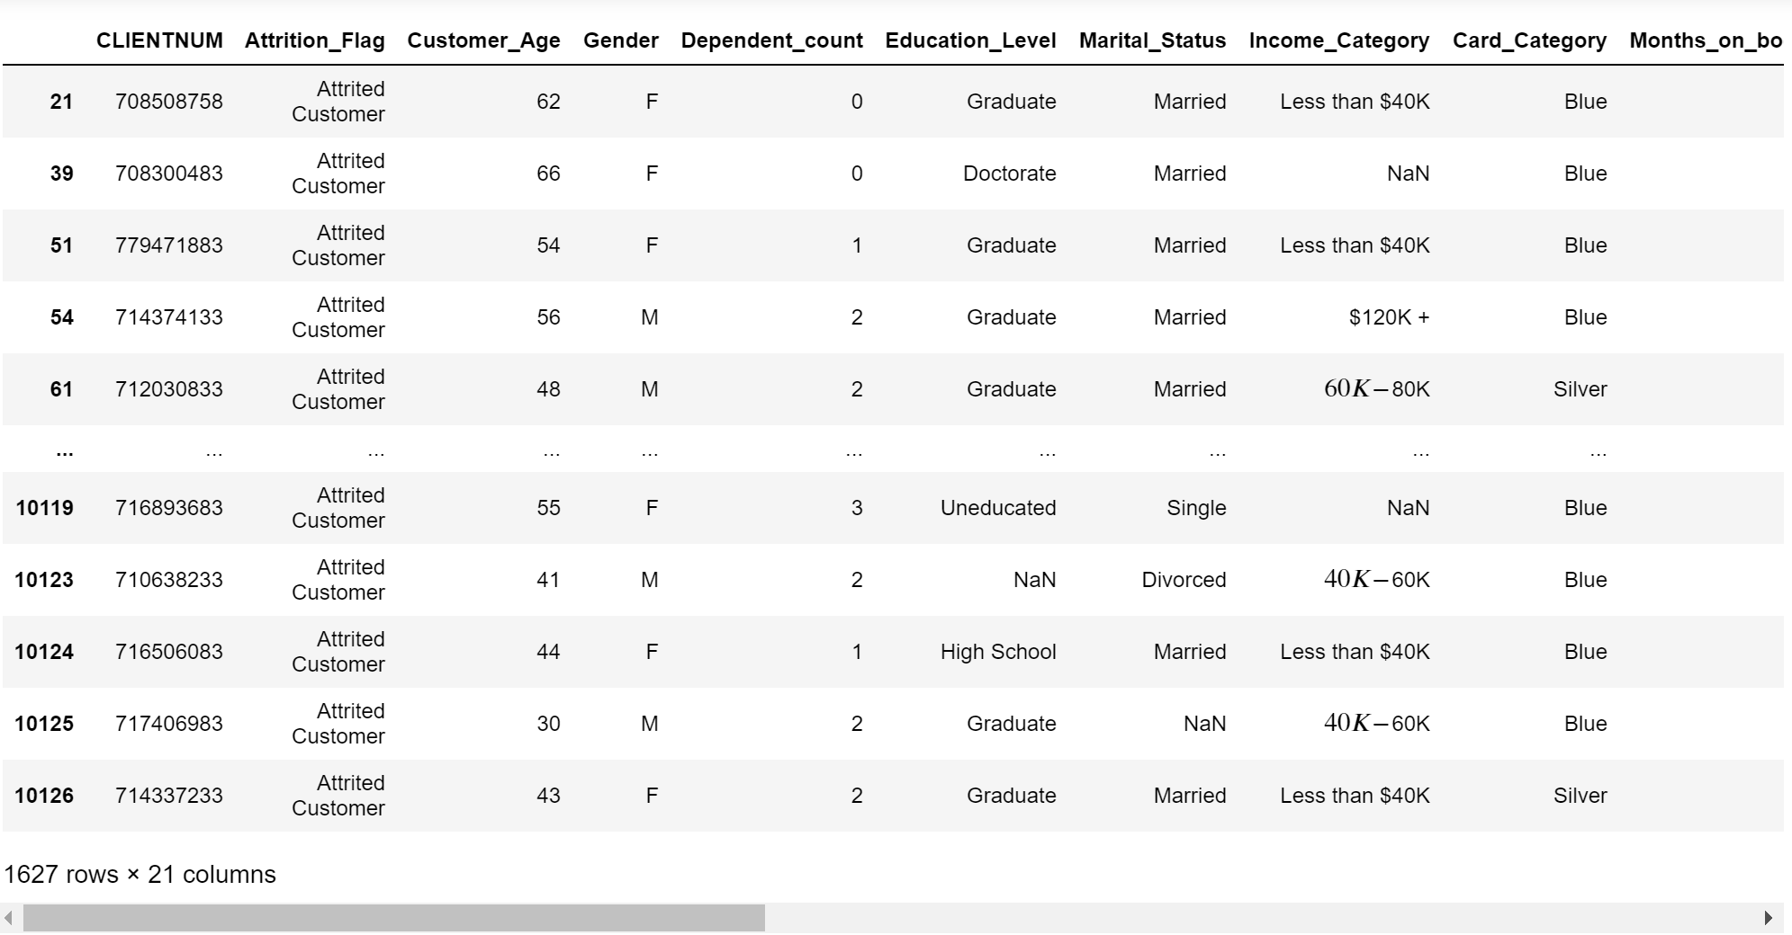
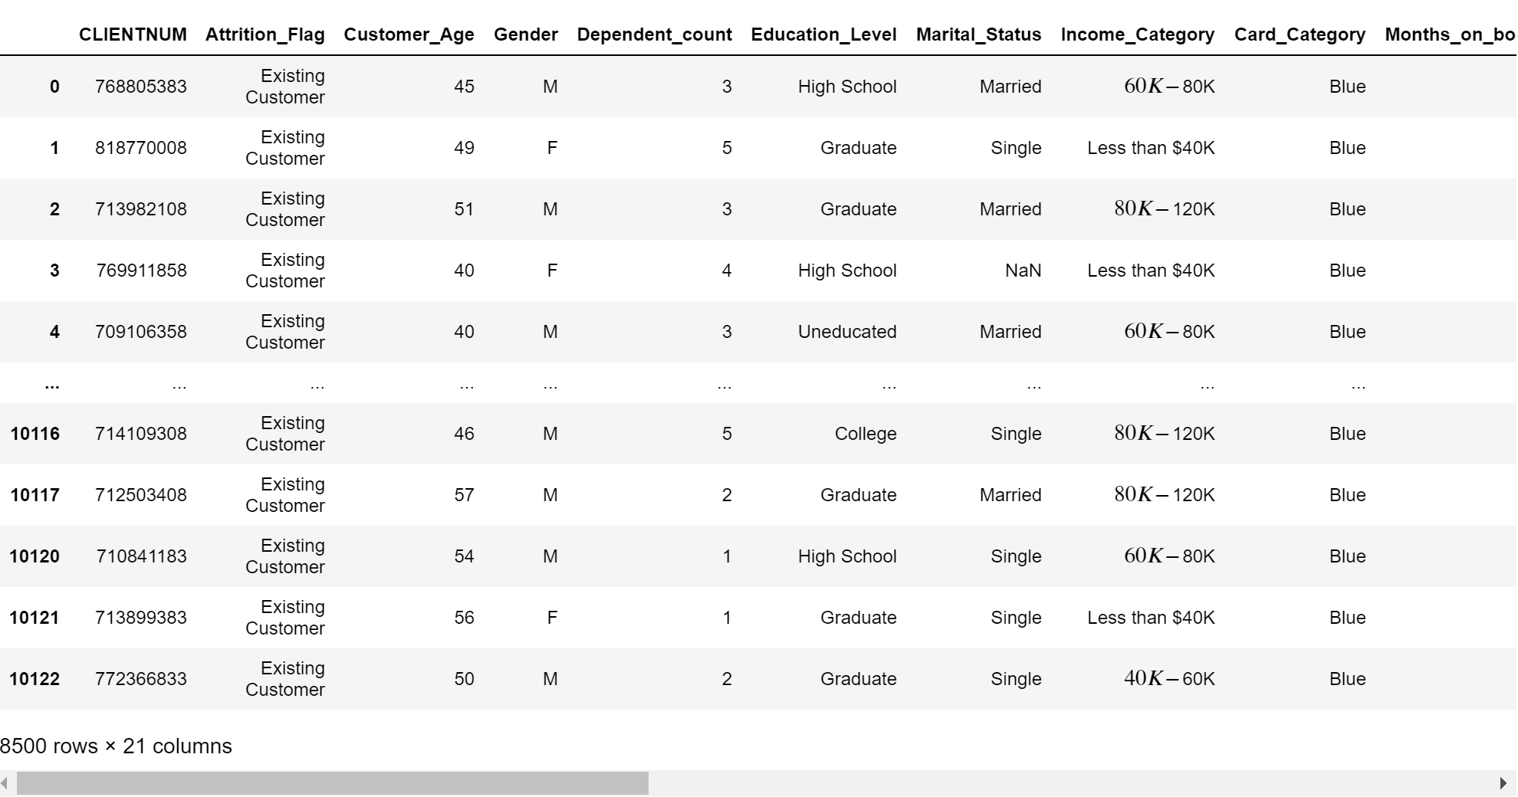
Attributed and
Existing Customers
2 tables
1627 attributed
8500 existing
19:100 ratio

Slide 6
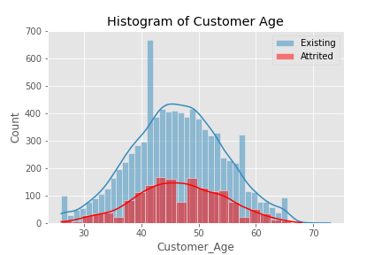
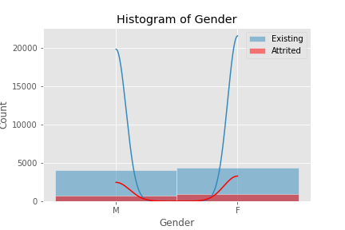
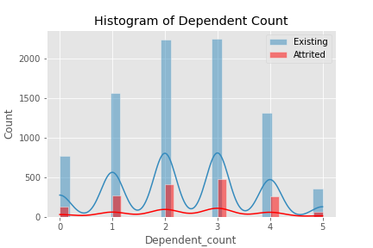
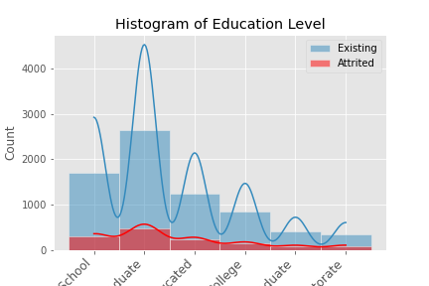
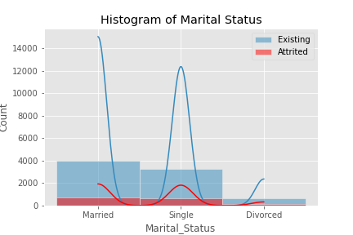

Slide 7
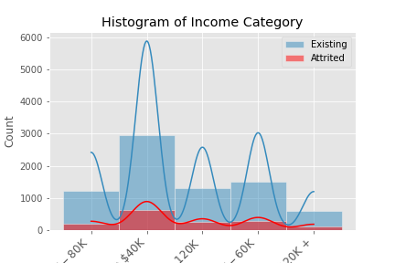
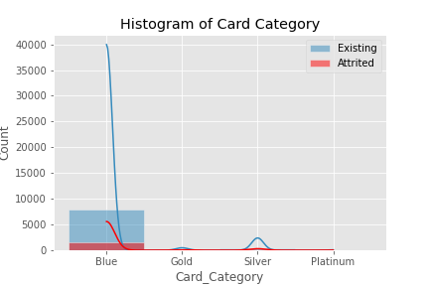
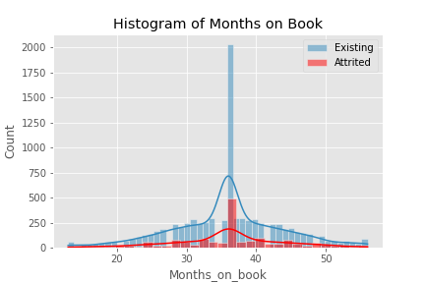
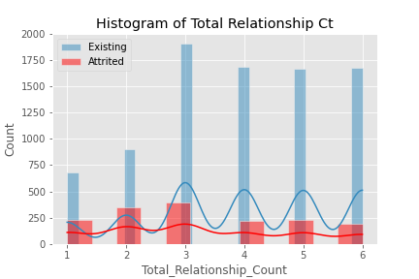
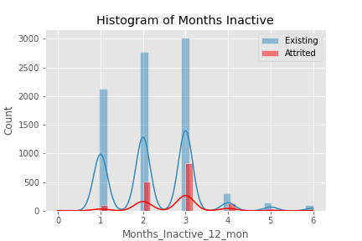

Slide 8
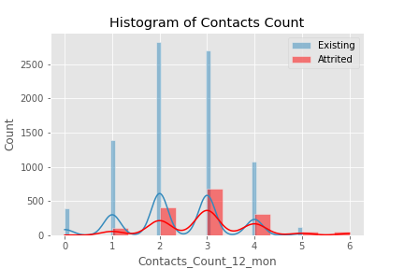
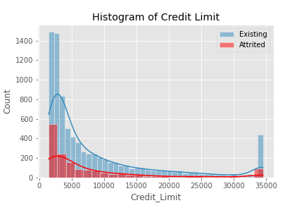
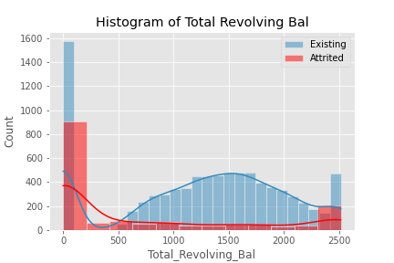
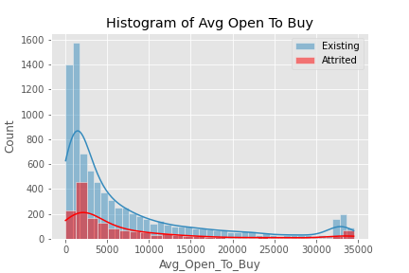
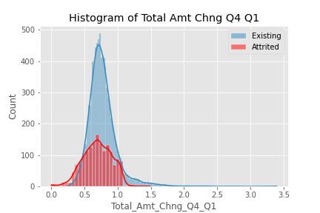

Slide 9
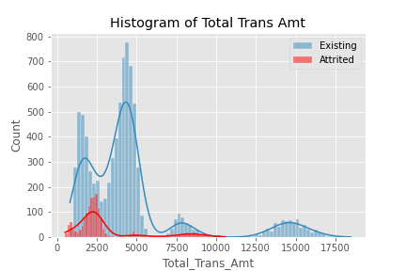
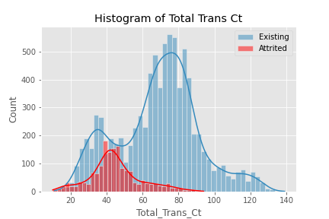
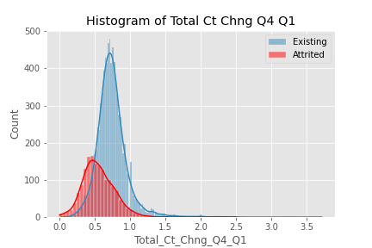
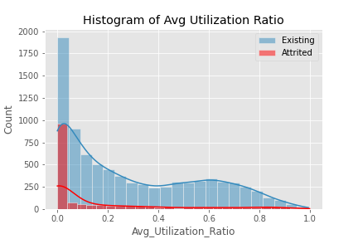

Slide 10
Identify Relevant Factors
Dependent Factors
Total_Revolving_bal of $0
Total_Amt_Chng_Q4_Q1 of 0.701
Total_Trans_Amt of $2,329
Total_Trans_Ct of 43
Total_Ct_Chng_Q4_Q1 of 0.531

Slide 11
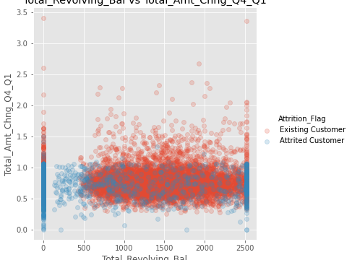
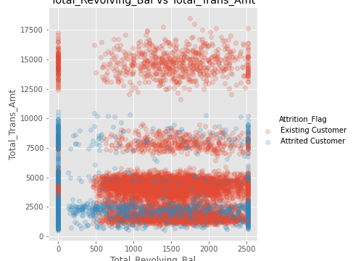
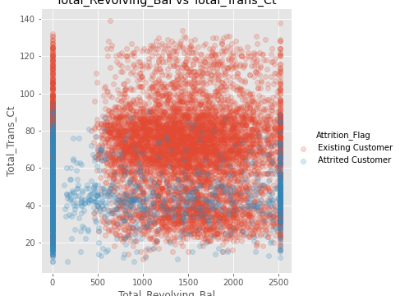
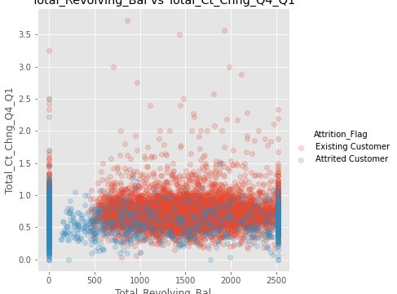
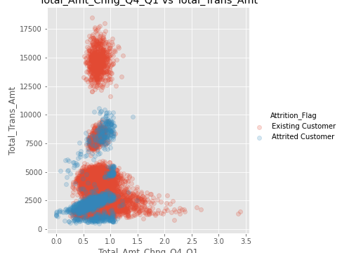

Slide 12
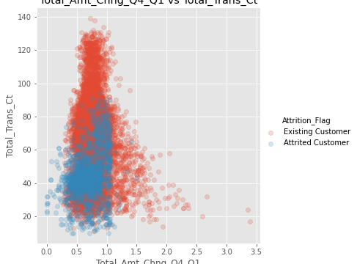
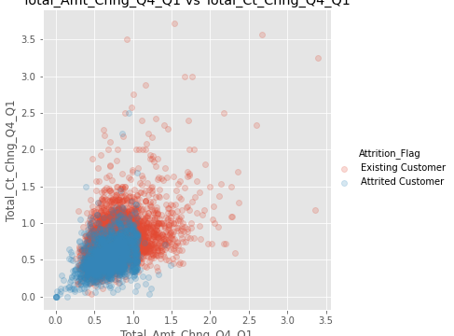
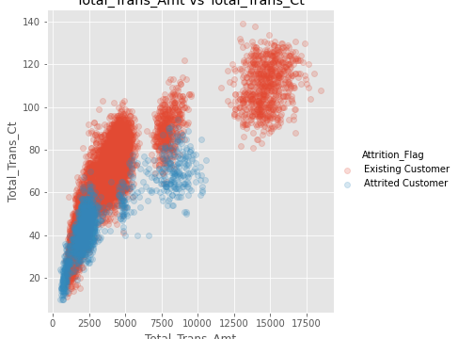
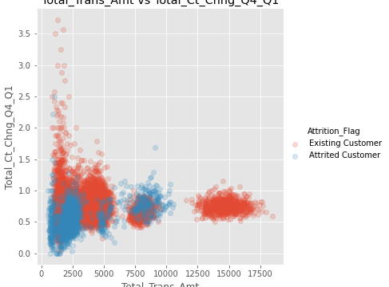
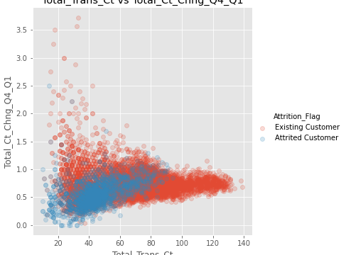

Slide 13
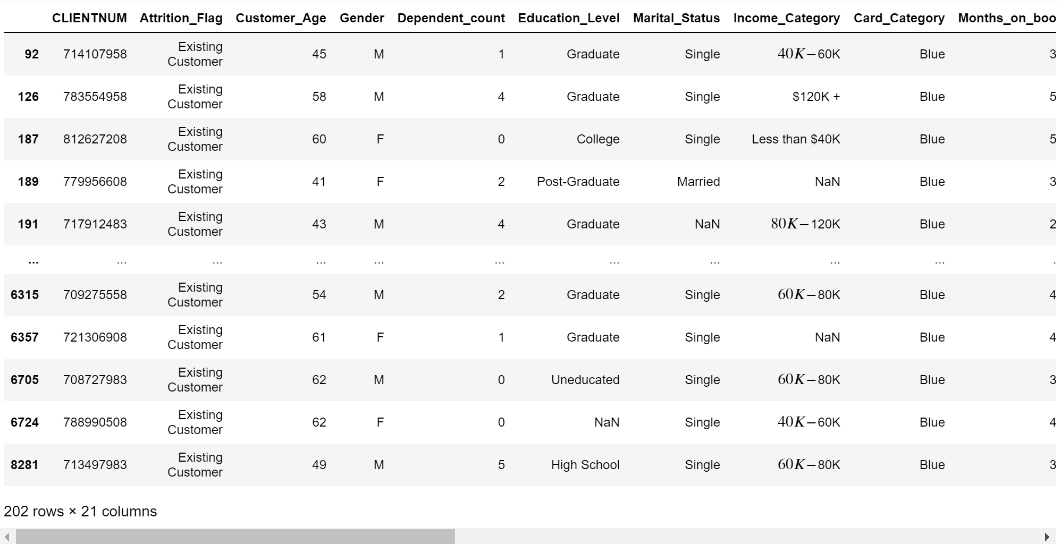
Show dataset of the people identified after findings & What can you do with this data
properly use our resources.
target those who are most likely to cancel
higher chance of customer retention

Slide 14
If I had more time I would...
use a stricter definition of a churner
request more customer data to identify them.
filter out cc applicants who are churners, the company will lose less money.
Notes:
dsfafw

